Slide 1
Database TREASURY GUIDELINE WORKSHOP JUNE 2018

Slide 2
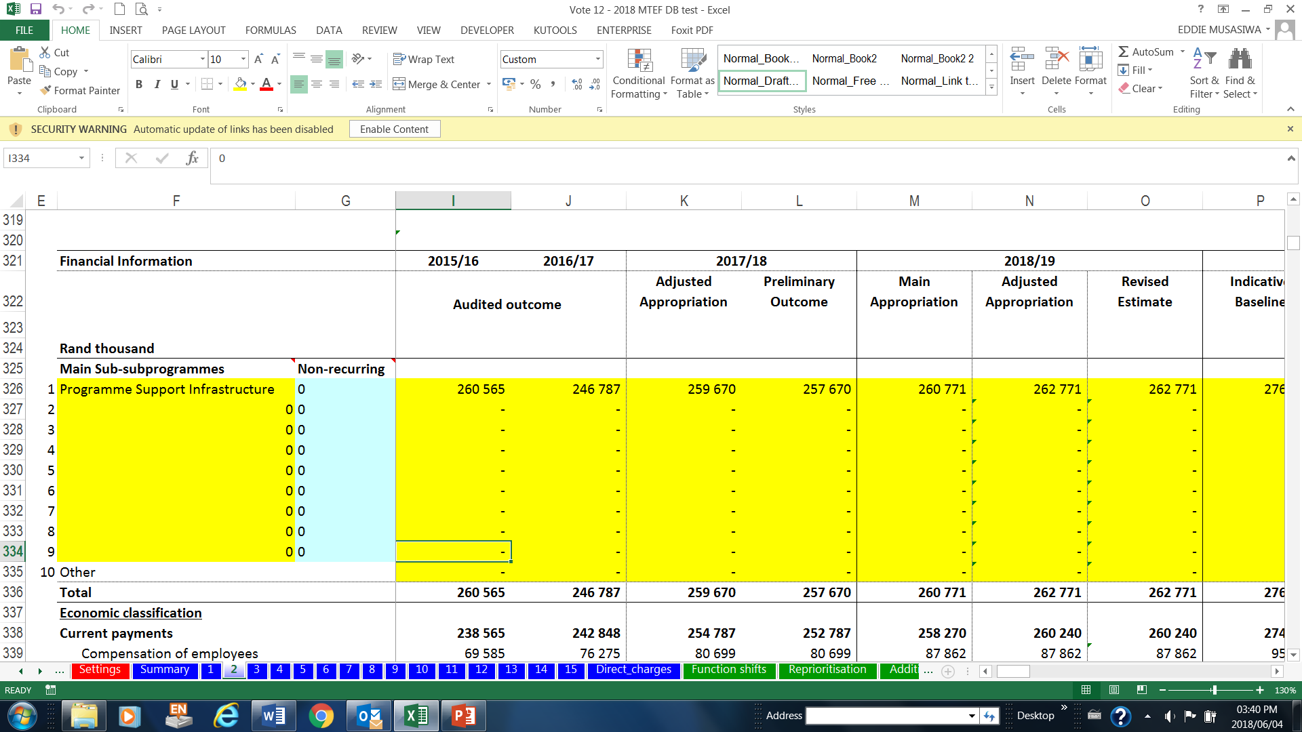
Source of information
1
Audited AFS
2
Unaudited AFS
3
2018/19 EPRE

Slide 3
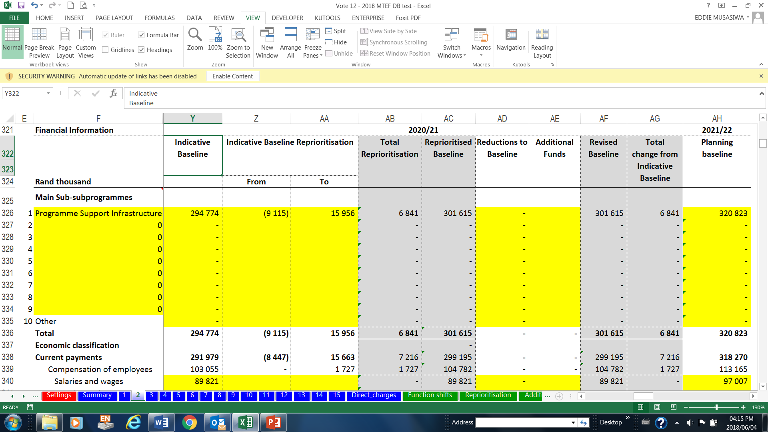
Source of information
5
Planning baseline
TG Estimates
4
Indicative Baselines
2018/19 EPRE

Slide 4
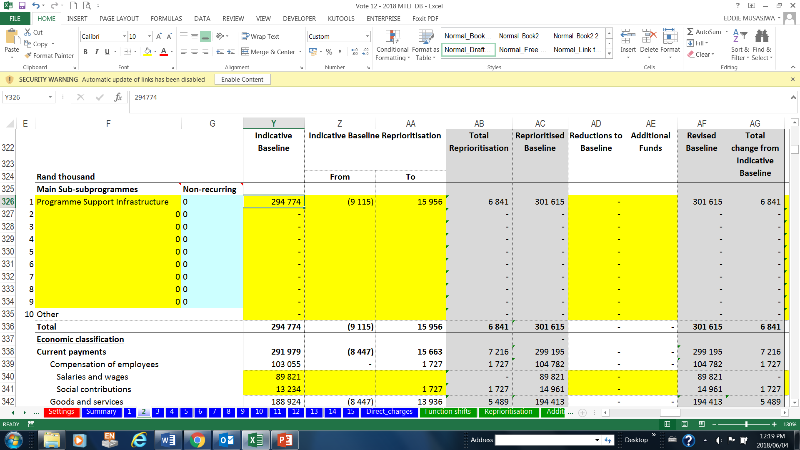
Updating the Database
Reprioritisations
Baseline changes

Slide 5
Summary of data sources
FINANCIAL YEAR | DATA SOURCE
2015/16 | 2015/16 Audited AFS/Annual Report
2016/17 | 2016/17 Audited AFS/Annual Report
2017/18 | 2017/18 Unaudited AFS
2018/19 Budget | 2018/19 EPRE
2018/19 Revised Estimate | 2018/19 June IYM
2019/20 Baseline | 2019/20 column in 2018/19 EPRE
2020/21 Baseline | 2020/21 column in 2018/19 EPRE
2021/22 Baseline | As per formula in the Treasury Guidelines

Slide 6
Capturing of numbers with decimals
Attempting to correct formulas (may lead in depts. recapturing)
Note that if tables with decimals will be returned for correction
Make sure the financial year for the database is correct
Capturing in the yellow shaded section
Copy and paste value (formulas in the yellow-shaded section)

Slide 7
Conclusion
Working together we can do more

